Slide 1
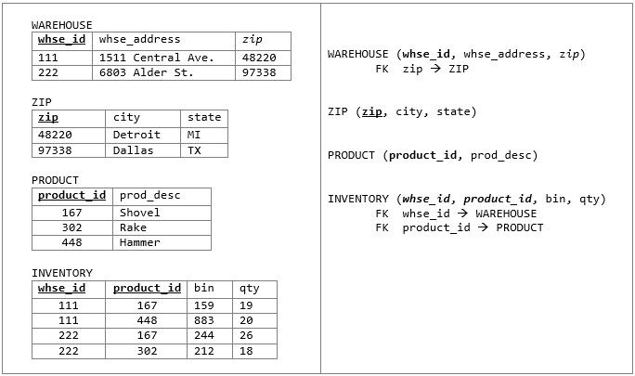
Inventory Database in 3NF

Slide 2
Let's consider another example
Property Management Company manages client's rental properties

Slide 3
Un-Normalized Client Rental Data
Contains multivalued attributes
client_id | client_name | property_id | address | rent_start | rent_finish | rent | renter_id | renter_name
CR76 | John Kay | PG4 PG16 | 6 lawrence St,Glasgow 5 Novar Dr, Glasgow | 2000-07-01 2002-09-01 | 2005-08-31 2007-09-30 | 350 450 | CO40 CO93 | Tina Murphy Tony Shaw
CR56 | Aline Stewart | PG4 PG36 PG16 | 6 lawrence St,Glasgow 2 Manor Rd, Glasgow 5 Novar Dr, Glasgow | 2007-05-15 2008-10-01 2008-11-01 | 2010-06-30 2012-12-31 2013-08-31 | 350 370 450 | CO40 CO93 CO93 | Tina Murphy Tony Shaw Tony Shaw

Slide 4
1NF with the first approach
Remove the multivalued attributes (property rented details) by entering appropriate data in the empty columns of rows containing the repeating data

Slide 5
1NF - first approach
A table representing client rental data in 1NF
CLIENT_RENTAL ( client_id, property_id, client_name, address, rent_start, rent_finish, rent, renter_id, renter_name )
client_id | property_id | client_name | address | rent_start | rent_finish | rent | renter_id | renter_name
CR76 | PG4 | John Kay | 6 lawrence St,Glasgow | 2000-07-01 | 2005-08-31 | 350 | CO40 | Tina Murphy
CR76 | PG16 | John Kay | 5 Novar Dr, Glasgow | 2002-09-01 | 2007-09-30 | 450 | CO93 | Tony Shaw
CR56 | PG4 | Aline Stewart | 6 lawrence St,Glasgow | 2007-05-15 | 2010-06-30 | 350 | CO40 | Tina Murphy
CR56 | PG36 | Aline Stewart | 2 Manor Rd, Glasgow | 2008-10-01 | 2012-12-31 | 370 | CO93 | Tony Shaw
CR56 | PG16 | Aline Stewart | 5 Novar Dr, Glasgow | 2008-11-01 | 2013-08-31 | 450 | CO93 | Tony Shaw

Slide 6
1NF - second approach - SKIP
CLIENT (client_id, client_name)
RENTAL (client_id, property_id, address, rent_start, rent_finish, rent, renter_id, renter_name)
client_id | client_name
CR76 | John Kay
CR56 | Aline Stewart
client_id | property_id | address | rent_start | rent_finish | rent | renter_id | renter_name
CR76 | PG4 | 6 lawrence St,Glasgow | 2000-07-01 | 2005-08-31 | 350 | CO40 | Tina Murphy
CR76 | PG16 | 5 Novar Dr, Glasgow | 2002-09-01 | 2007-09-30 | 450 | CO93 | Tony Shaw
CR56 | PG4 | 6 lawrence St,Glasgow | 2007-05-15 | 2010-06-30 | 350 | CO40 | Tina Murphy
CR56 | PG36 | 2 Manor Rd, Glasgow | 2008-10-01 | 2012-12-31 | 370 | CO93 | Tony Shaw
CR56 | PG16 | 5 Novar Dr, Glasgow | 2008-11-01 | 2013-08-31 | 450 | CO93 | Tony Shaw

Slide 7
2NF Partial Dependencies
Partial dependencies:
client_id → client_name
property_id → address, rent, renter_id, renter_name
client_id | property_id | client_name | address | rent_start | rent_finish | rent | renter_id | renter_name
CR76 | PG4 | John Kay | 6 lawrence St,Glasgow | 2000-07-01 | 2005-08-31 | 350 | CO40 | Tina Murphy
CR76 | PG16 | John Kay | 5 Novar Dr, Glasgow | 2002-09-01 | 2007-09-30 | 450 | CO93 | Tony Shaw
CR56 | PG4 | Aline Stewart | 6 lawrence St,Glasgow | 2007-05-15 | 2010-06-30 | 350 | CO40 | Tina Murphy
CR56 | PG36 | Aline Stewart | 2 Manor Rd, Glasgow | 2008-10-01 | 2012-12-31 | 370 | CO93 | Tony Shaw
CR56 | PG16 | Aline Stewart | 5 Novar Dr, Glasgow | 2008-11-01 | 2013-08-31 | 450 | CO93 | Tony Shaw

Slide 8
2NF ClientRental
CLIENT (client_id, client_name)
PROPERTY (property_id, address, rent, renter_id, renter_name)
RENTAL (client_id, property_id, rent_start, rent_finish)
RENTAL
CLIENT
client_id | property_id | rent_start | rent_finish
CR76 | PG4 | 2000-07-01 | 2005-08-31
CR76 | PG16 | 2002-09-01 | 2007-09-30
CR56 | PG4 | 2007-05-15 | 2010-06-30
CR56 | PG36 | 2008-10-01 | 2012-12-31
CR56 | PG16 | 2008-11-01 | 2013-08-31
client_id | client_name
CR76 | John Kay
CR56 | Aline Stewart
PROPERTY
property_id | address | rent | renter_id | renter_name
PG4 | 6 lawrence t,Glasgow | 350 | CO40 | Tina Murphy
PG16 | 5 Novar Dr, Glasgow | 450 | CO93 | Tony Shaw
PG36 | 2 Manor Rd, Glasgow | 370 | CO93 | Tony Shaw

Slide 9
3NF ClientRental
The transitive dependencies are :
renter_id → renter_name
PROPERTY
property_id | address | rent | renter_id | renter_name
PG4 | 6 lawrence St,Glasgow | 350 | CO40 | Tina Murphy
PG16 | 5 Novar Dr, Glasgow | 450 | CO93 | Tony Shaw
PG36 | 2 Manor Rd, Glasgow | 370 | CO93 | Tony Shaw

Slide 10
3NF ClientRental
The resulting 3NF tables:
CLIENT ( client_id, client_name )
PROPERTY ( property_id, address, rent, owner_id, renter_id )
RENTAL ( client_id, property_id, rent_start, rent_finish )
RENTER ( renter_id, renter_name )

Slide 11
3NF ClientRental
CLIENT
RENTAL
client_id | client_name
CR76 | John Kay
CR56 | Aline Stewart
client_id | property_id | rent_start | rent_finish
CR76 | PG4 | 2000-07-01 | 2005-08-31
CR76 | PG16 | 2002-09-01 | 2007-09-30
CR56 | PG4 | 2007-05-15 | 2010-06-30
CR56 | PG36 | 2008-10-01 | 2012-12-31
CR56 | PG16 | 2008-11-01 | 2013-08-31
PROPERTY
RENTER
property_id | address | rent | owner_id
PG4 | 6 lawrence St,Glasgow | 350 | CO40
PG16 | 5 Novar Dr, Glasgow | 450 | CO93
PG36 | 2 Manor Rd, Glasgow | 370 | CO93
renter_id | renter_name
CO40 | Tina Murphy
CO93 | Tony Shaw

Slide 12


